Slide 1
Discrete Fourier Transform (DFT)

Slide 2
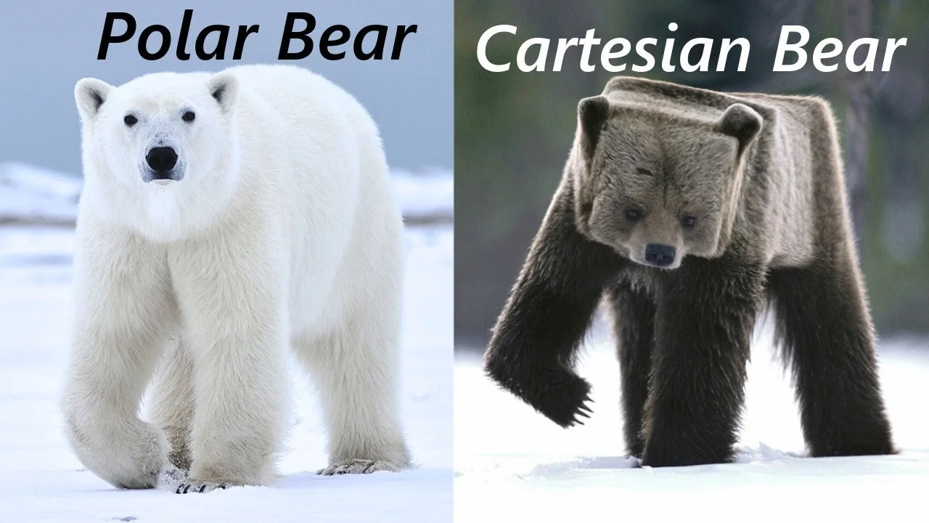
Introduction - complex numbers

Slide 3
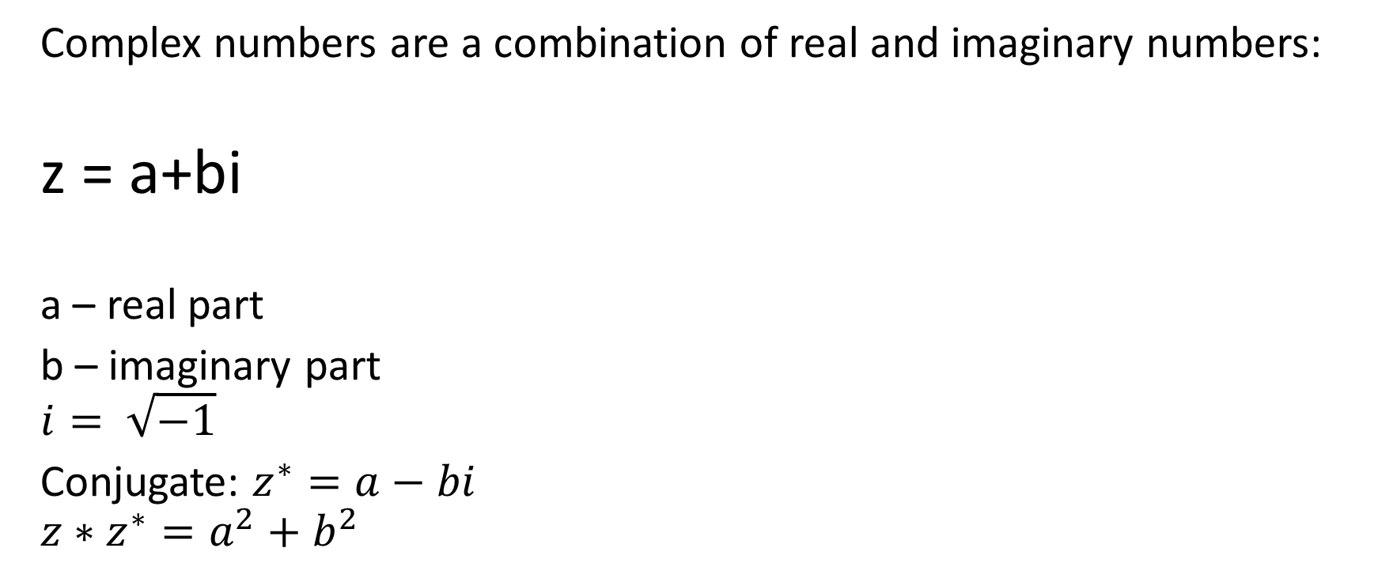
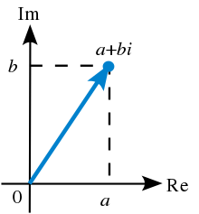
Complex Numbers

Slide 4
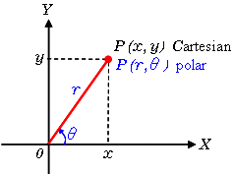
Polar form
Any vector can be represented in a polar form (r, theta), amplitude and angle, or in a cartesian form (x,y)

Slide 5
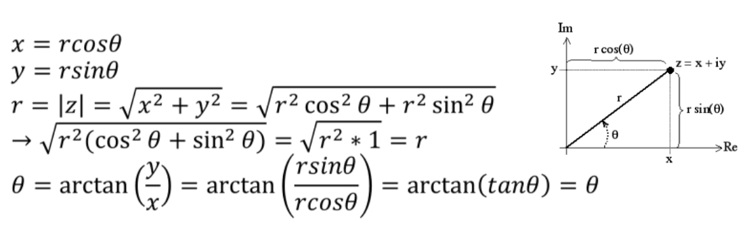
Polar form
Any vector can be represented in a polar form (r, theta), amplitude and angle, or in a cartesian form (x,y)

Slide 6
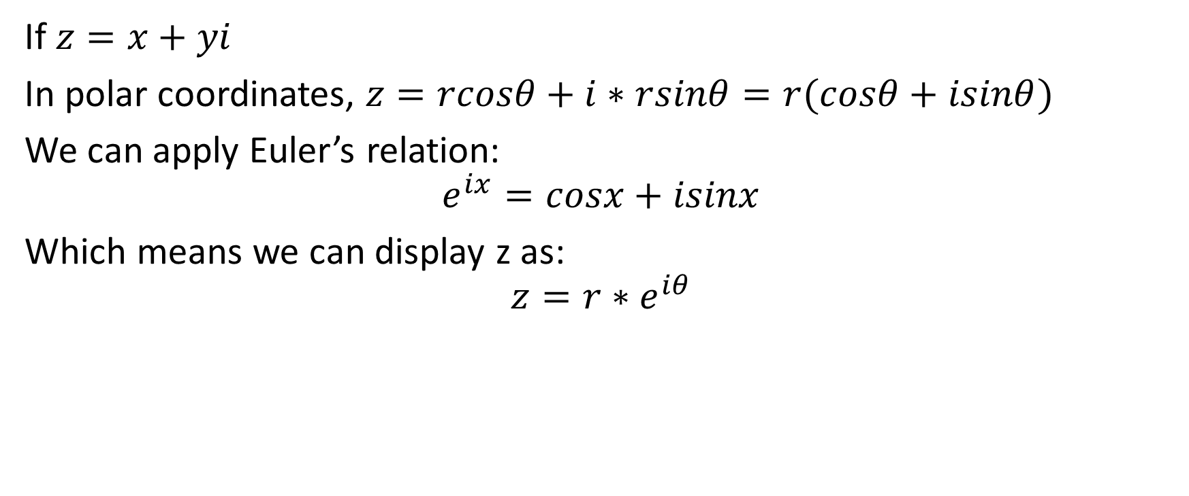
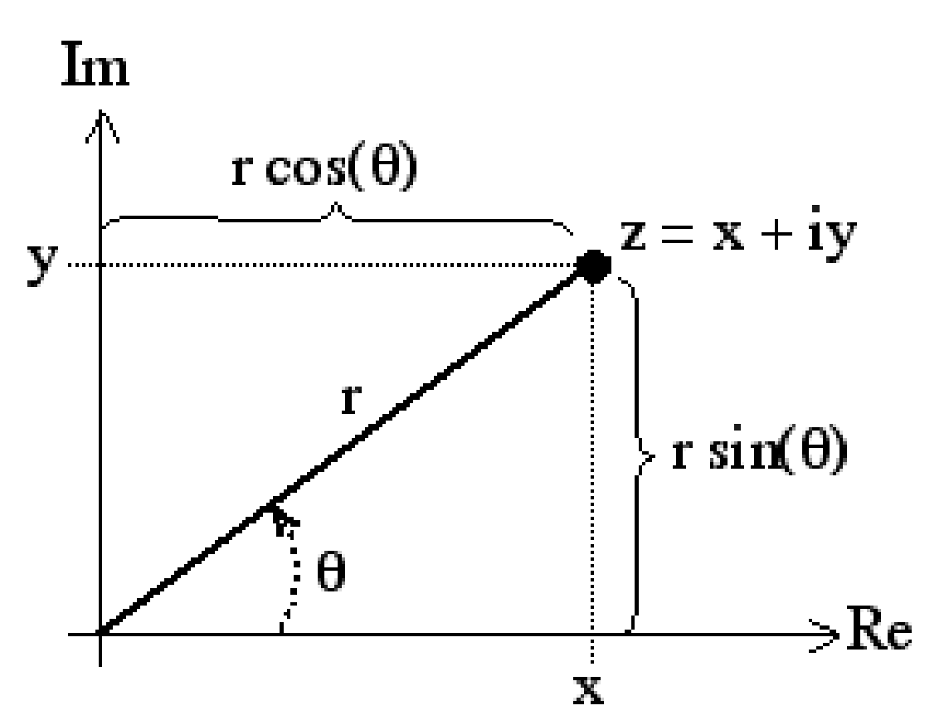
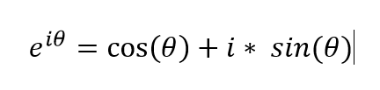

Complex numbers in polar form

Slide 7
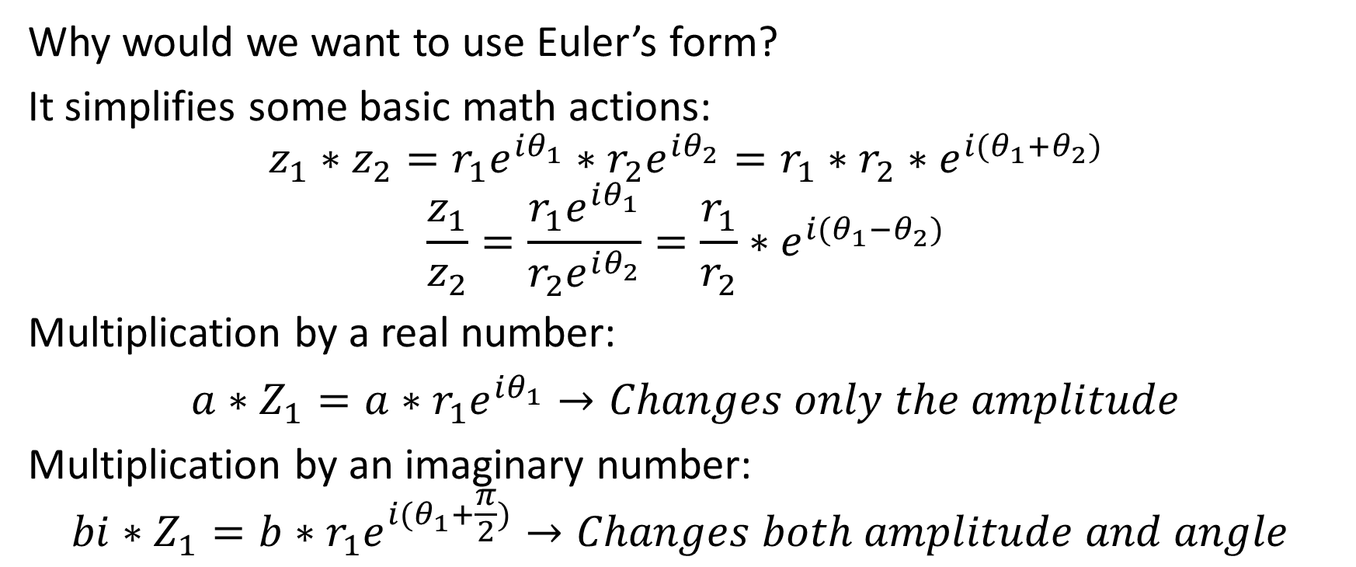
Complex numbers in polar form

Slide 8
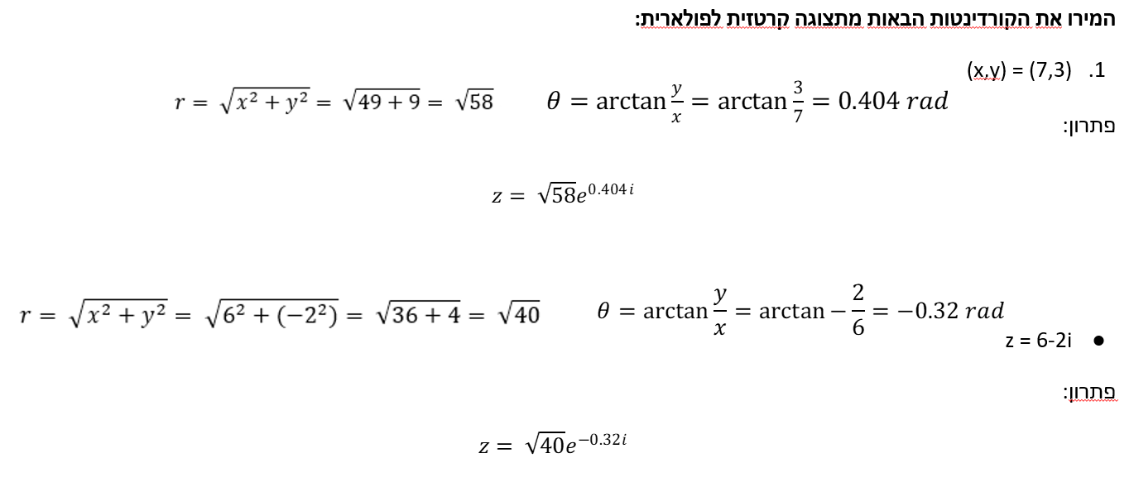
Examples
Notes:
\לשנות את הזווית לרדיאנים

Slide 9
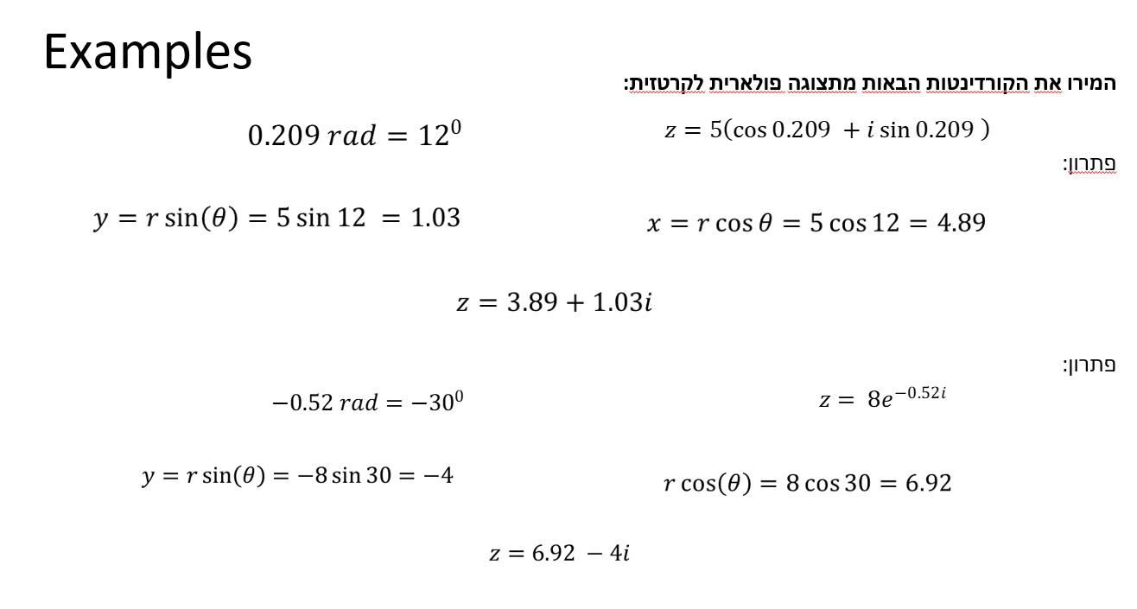

Slide 10
Real and imaginary amplitudes
The sine amplitude is represented by the imaginary part of X
The cosine amplitude is represented by the real part of X

Slide 11
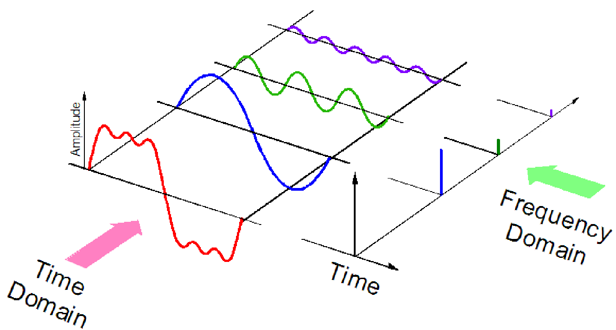
Discrete Fourier Transform (DFT)
The DFT transforms a signal from the time domain to the frequency domain. Can be accomplished since every signal can be represented as a combination of sine waves.

Slide 12

Discrete Fourier Transform (DFT)
The transform is calculated by:
N – Number of sampling points (points in the signal)
n – Sampling index (0,1,2,…,N-1)
k - Frequency

Slide 13

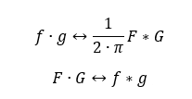
DFT - formulas and features
Inverse:
Convolution and Multiplication
(AKA “Convolution theorem”)

Slide 14
How do we read the DFT result?
When we apply a Fourier transform on a signal x(n), we will get X(k) a series of complex numbers (same length of the original signal).
At each value k, the real part of the complex number describes the amplitude of a Cosine wave at a given frequency, and the imaginary part describes the amplitude of a Sine wave at the same frequency.
We can obtain them in matlab by using:
Real(X) and Imag(X) functions

Slide 15


DFT - formulas and features
Parseval
linearity

Slide 16
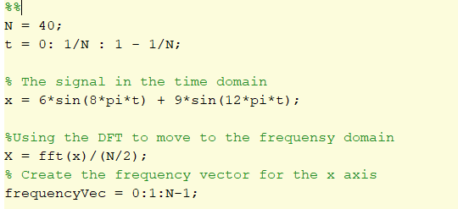
DFT – Code example
Notes:
לשנות

Slide 17
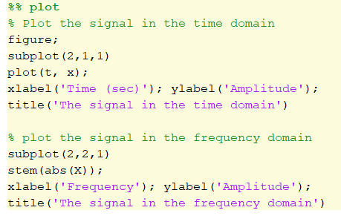
DFT – Code example - how to plot

Slide 18

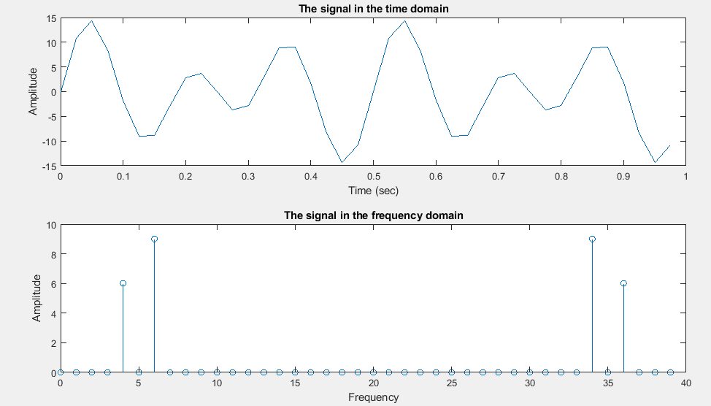
DFT – Matlab example

Slide 19
DFT – online example

Slide 20
DFT – Manual example
Calculate the DFT at 4Hz for the signal x=5*Sin(4*2π), use N=10.
First, we need to find the values of x(n)= 5*Sin(4*2π*n/N):
x(n=0)=0
x(n=1)=5*sin(4*2π*1/10)=2.939
x(n=2)=5*sin(4*2π*2/10)=-4.756
x(n=3)=5*sin(4*2π*3/10)=4.756
x(n=4)=5*sin(4*2π*4/10)=-2.939
x(n=5)=0
x(n=6)=5*sin(4*2π*6/10)=2.939
x(n=7)=5*sin(4*2π*7/10)=-4.756
x(n=8)=5*sin(4*2π*8/10)=4.756
x(n=9)=5*sin(4*2π*9/10)=-2.939
Notes:
?

Slide 21
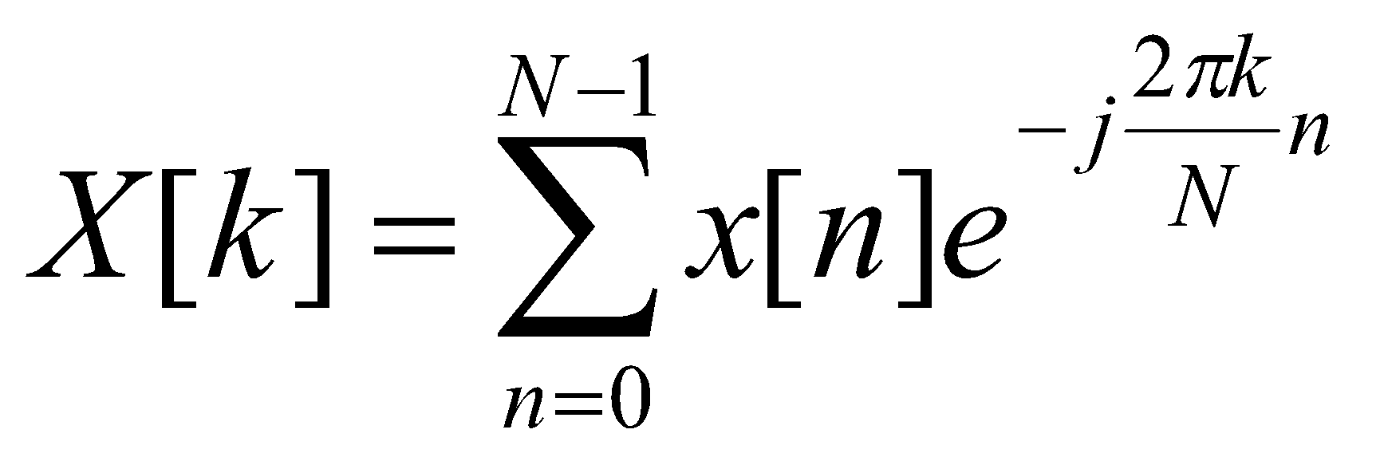
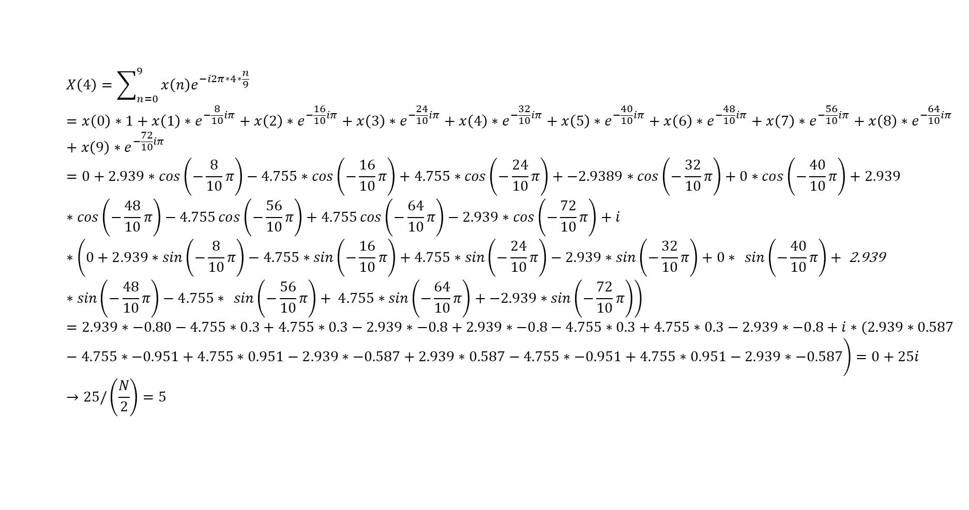
DFT – Manual example
x(n=0)=0
x(n=1)=2.939
x(n=2)=-4.756
x(n=3)=4.756
x(n=4)=-2.939
x(n=5)=0
x(n=6)=2.939
x(n=7)=-4.756
x(n=8)=4.756
x(n=9)=-2.939

Slide 22
Question:
Assume you computed a 8 points DFT in one second (e.g use t=0:1/8:1-1/8 or t=(0:7)/8) on signal x to obtain X. what you expect the X values to be if (verify with fft in matlab):
a. x=1*sin(2*pi*t*2)
b. x=5*cos(2*pi*t*3)
c. x=2*cos(2*pi*t*2) +2*cos(2*pi*t*1)
d. x=2*cos(2*pi*t*3) -2*cos(2*pi*t*1)
e. x=4*sin(2*pi*t*1)+3*cos(2*pi*t*5) % note the nyquist frequency

Slide 23
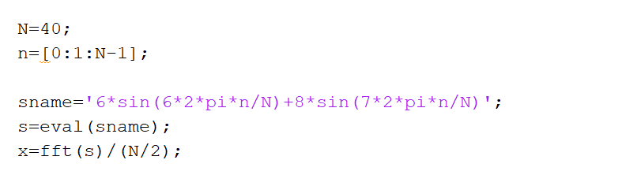
DFT – Matlab example

Slide 24
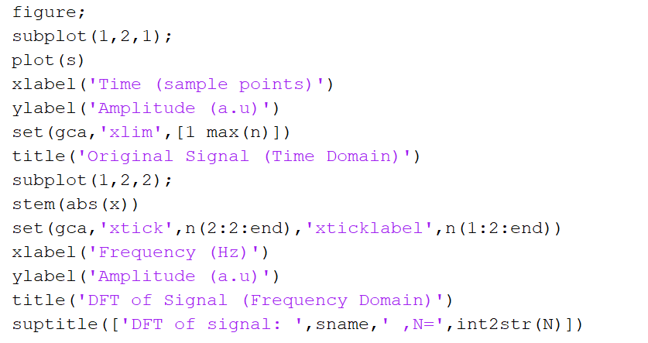
DFT – Matlab example

Slide 25
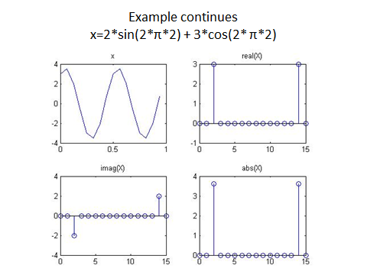
For k = 2Hz, the complex number is 3+2i.
The absolute value is:
sqrt(a^2 + b^2)

Slide 26
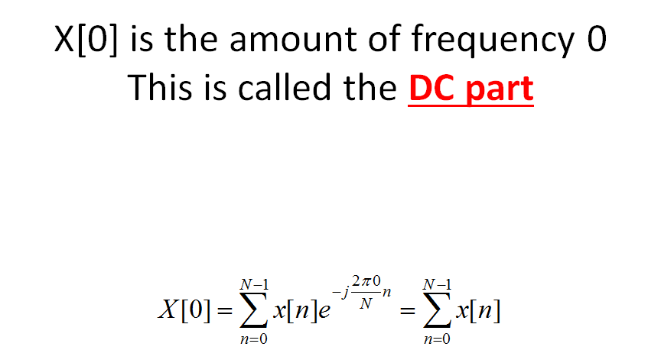
We normalize the DC value by N
(Remember that we normalize all the other values by N/2)

Slide 27
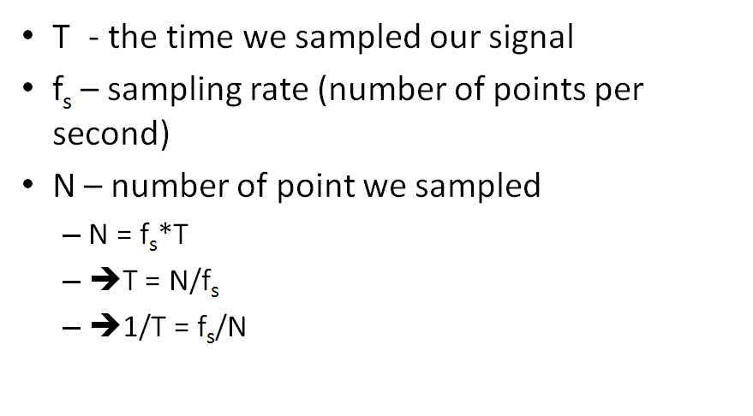
Resolution of DFT

Slide 28
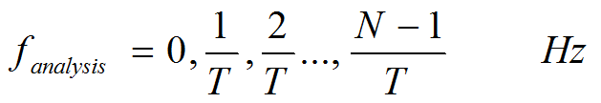
Resolution of DFT
Example
We have a 5 seconds signal, and Fs = 10Hz.
How many points do we have (N)?
What is the resolution of F_analysis?
What is the nyquist frequency?

Slide 29
Resolution of DFT
Solution
We have a 5 seconds signal, and Fs = 10Hz.
How many points do we have (N)? 50 points
What is the resolution of F_analysis? 1/5Hz
What is the nyquist frequency? 5Hz

Slide 30
The phase of the DFT result
For frequency k, X[k] = a+bi
The phase of frequency k is atan(b/a).

Slide 31
Example #1:
Given:
t = 0:0.01:1-0.01;
x = 6.*cos(2*pi*5 + pi/4);
N = ?
X = fft(x)./(N/2)
X[5] = 4.2426 + 4.2426i
Phase = atan(4.2426/4.2426) = pi/4

Slide 32
Example #2:
Given:
t = 0:0.01:3-0.01;
x = 3*sin(2*pi*3) + 6.*cos(2*pi*5 + pi/8);
N = ?
X = fft(x)./(N/2)
X[5Hz] = 5.5433 + 2.2961i
X[3Hz] = 0 - 3i
Phase[5Hz] = atan(2.2961/5.5433) = pi/8
Phase[3Hz] = atan(3/0) = -pi/2

Slide 33
•Let x= 5*cos(2*pi*12)+ 2*cos(2*pi*18)
•You sampled 200 points in 0.5 seconds
–What is the frequency resolution?
–What is the Nyquist frequency?
–How will the power spectrum will look like?
–How will the angle spectrum will look like?

Slide 34
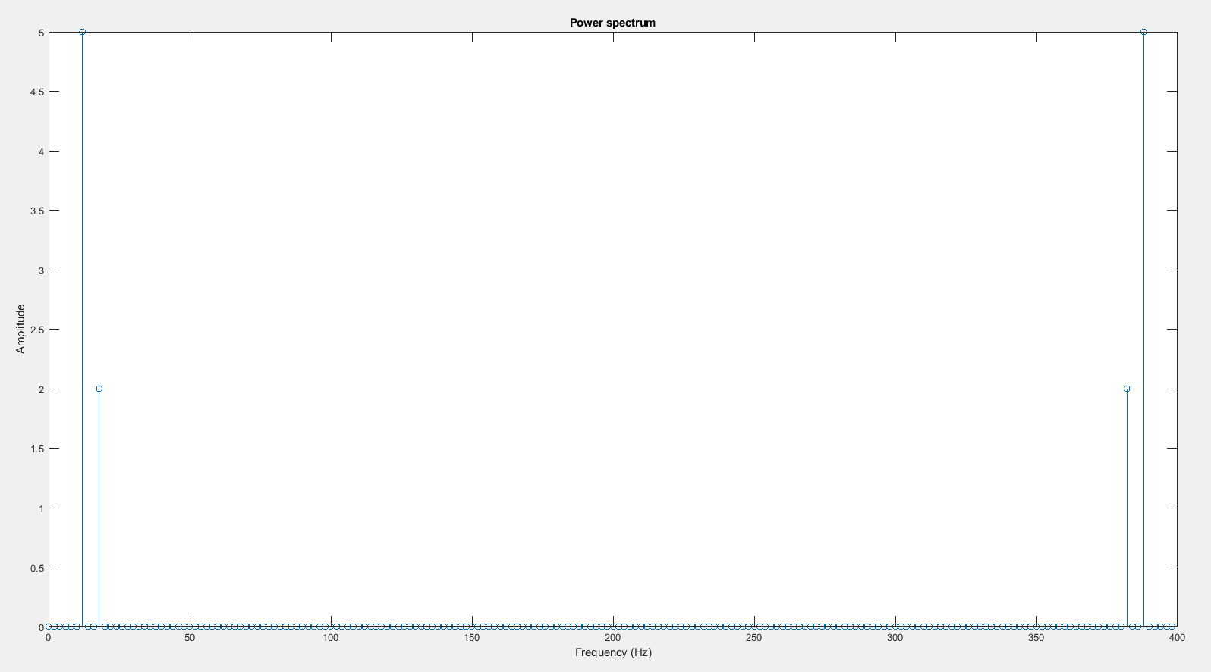
Power spectrum

Slide 35
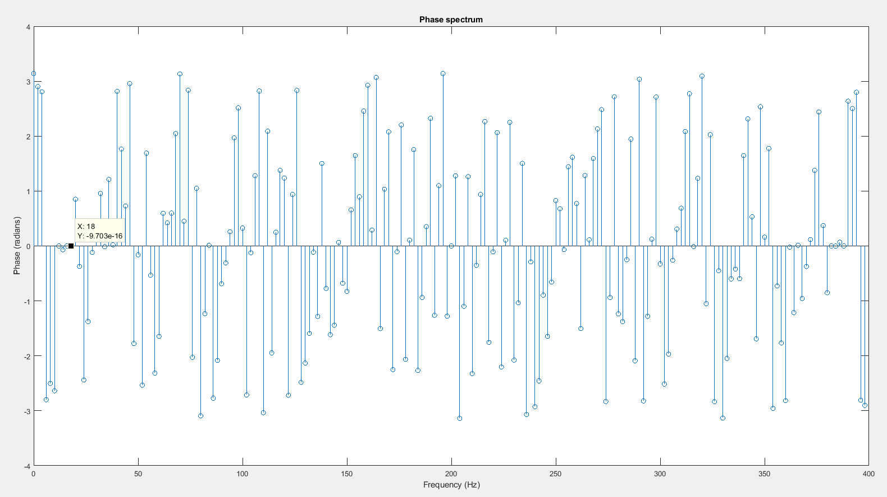
Angle:

Slide 36
Another example
Let x= 2*sin(2*pi*10)+ 5*sin(2*pi*16)
You sampled 50 points in 2 seconds
What is frequency resolution?
How will the power spectrum will look like?
How will the angle spectrum will look like?

Slide 37
Solution
We have alias! Fs of 25Hz is below the Nyquist frequency
(which should be at least 16Hz*2 = 32Hz)
F alias = |16-25| = 9Hz
Resolution:
N=50, T=2, fs = 50/2 = 25 samples/sec
f_{analysis} = 1/T = 0.5 Hz
Frequency range = 0,0.5,1,….24.5 Hz
Spectral analysis:
The frequencies should be 10 and 9 Hz
Their amplitudes are 2 and 5 respectively
f_{analysis} divides 10 and 9 so we should expect a peak at each of these frequencies and in the symmetric parts

Slide 38
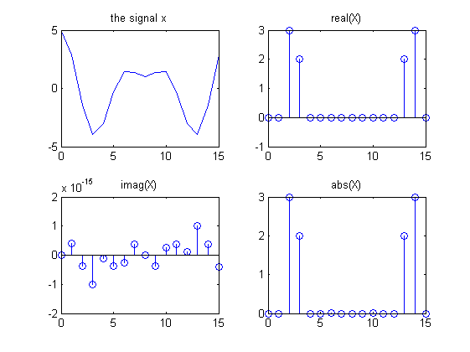
Examples x=3*cos(2*π*2) + 2*cos(2* π*3)

Slide 39
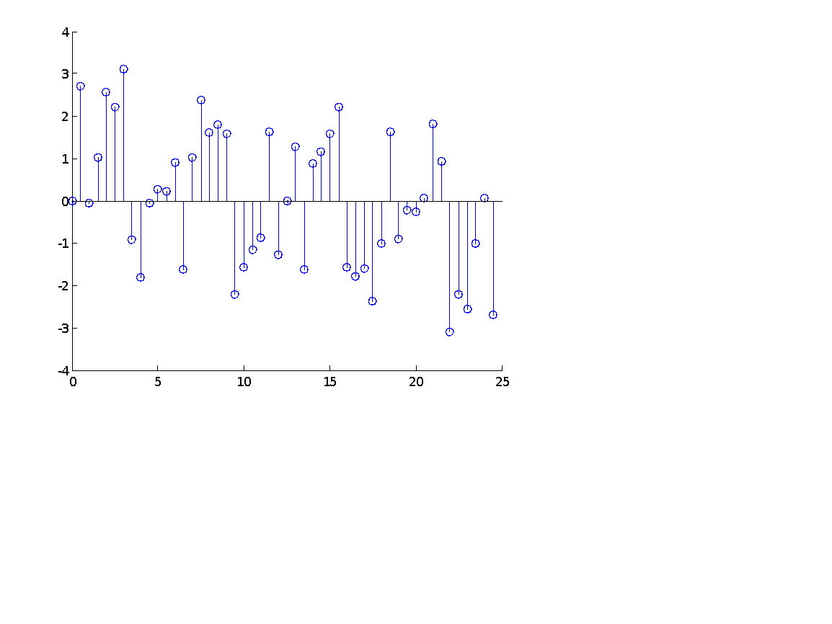
Solution
5
Angle spectrum
We have only sinus so the phase
should be -pi/2 in 9 and 10 Hz
Testing our answer
N=50; n=0:N-1; T=2; fs=N/T;
t=0:1/fs:T-1/fs;
x = 2*sin(2*pi*10*t)+ 5*sin(2*pi*16*t);
plot(n,x)
X=fft(x)/(N/2);
f_{range} = 1/T.*n;
figure; stem(frange, abs(X))
figure; stem(frange, angle(X))
Note: the phase in 9 hz is flipped
4.5
4
3.5
3
Amplitude
2.5
2
1.5
1
0.5
0
0
5
10
15
20
25
Frequency (Hz)
Phase
Frequency (Hz)

Slide 40
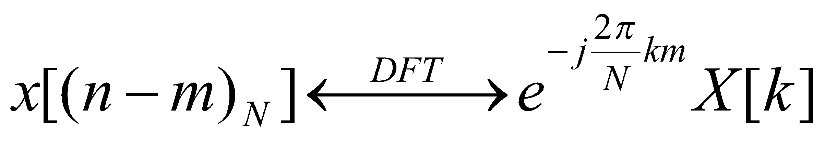

Phase theorem
Shifting the signal in the time domain DOES NOT affect the frequencies in the Frequency domain. It does however, changes the Phase.
circular shift on time domain leads to a phase shift on frequency domain.
for a time shift of m samples, the phase shift at the kth frequency will be

Slide 41
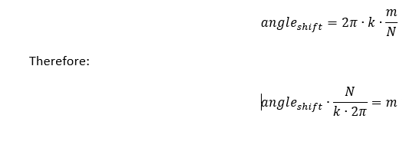
Phase theorem
phase shift on frequency domain → cyclic shift on time domain:

Slide 42
Leakage
Leakage happens when our signal has frequencies that fall between values we can measure using our resolution.
We will see some power in nearby frequencies.

Slide 43
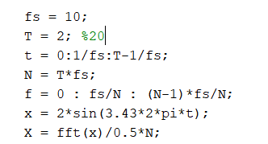
The effect of sampling time on Leakage

Slide 44
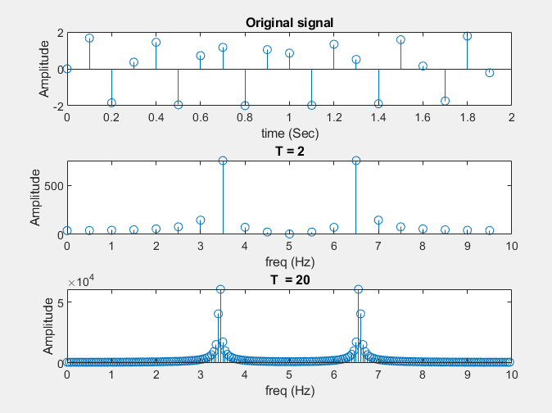
The effect of sampling time on Leakage

Slide 45
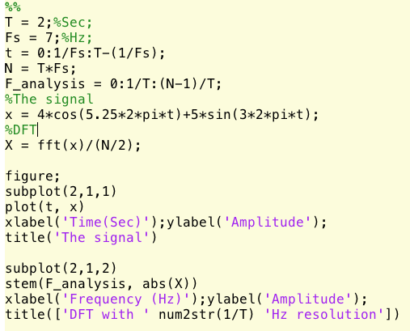
Leakage with aliasing – Example 2

Slide 46
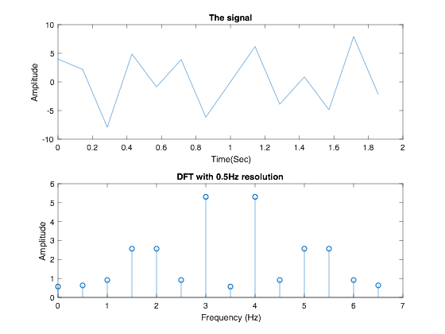
Leakage with aliasing – Example 2

Slide 47
Leakage -Matlab example
Let x= 5*cos(2*pi*11)+ 2*cos(2*pi*18)
You sampled 200 points in 0.5 seconds

Slide 48
Leakage correction using zero padding - Matlab example

Slide 49
Leakage correction using Hanning window - Matlab example

